Slide 1

NAV’s Horizon Scan 2021
Collage: Unsplash, Colourbox
Societal trends towards 2035 and the consequences for NAV
Notes:
NAV’s Horizon Scan discusses the most important societal trends that will affect the labour and welfare area towards 2035 and the potential consequences they may have for NAV.

Slide 2

Why do we need a Horizon Scan?
The pace of restructuring is accelerating – and NAV’s services must reflect and respond to this restructuring.
Reflection and discussions on opportunities and challenges provide an important basis for a new strategy in 2021
NAV employees are the main target group but we want to reach everyone who is involved with labour and welfare policy
Collage: Unsplash, Colourbox
Notes:
The purpose of the scan is twofold:
To help NAV to formulate more expedient strategies and plans for the years ahead. The findings of the Horizon Scan will be an important source when updating NAV’s corporate strategy in 2021.
To contribute to reflection and discussions on the opportunities and challenges NAV faces in the future, considering how these will affect NAV in general and how they will affect the individual areas.
An additional objective is to disseminate knowledge outside NAV. Many of the trends are also important for our partners. The scan can provide a picture of common challenges making it easier to cooperate across sectors and contribute to a more knowledge-based labour and welfare policy.

Slide 3
From a vision of the future to delivering change
Set the direction
Deliver change
Horizon Scan
Strategy and long-term plan
Overarching priorities
next year
Allocate resources
Vision of the future
The most important societal trends that will affect the area of labour and welfare towards 2035 and the consequences they may have for NAV.
Strategy and long-term plan
The strategy has the overall goals and priority areas, while the long-term plan is a concrete plan to meet the next four years
Resources
Ensure sufficient resources to deliver on priorities and establish measurable success criteria
Overarching priorities
The most important priorities that will move NAV in the right direction over the next year.
Source: Inspired by Deloitte (2018)
Notes:
Here you can see how we use the Horizon Scan today in the management of NAV.
On the left, we see the Horizon Scan – which is a vision of the future indicating potential opportunities and challenges. The Horizon Scan does not dictate what we should do. The direction we choose will be set out in NAV’s business strategy which includes overarching objectives and priority areas. These are further clarified in NAV’s long-term plan, which covers a period of 4 years ahead and is updated annually.
Each year we select overarching priorities from the long-term plan that will move NAV in the right direction over the next year. These priorities will have no consequences for our annual budgets, where we try to ensure sufficient resources to deliver on our priorities.

Slide 4
Knowledge and usefulness
How familiar are you with NAV’s Horizon Scan?
(6=very familiar, 1=not familiar at all)
How useful do you think the Scan is to your place of work?
(6=very useful, 1=not useful at all)
Employee
Manager
N=4,500 employees in NAV
Notes:
These findings are from a survey among NAV employees that was conducted in September 2020 and which included questions about how familiar the employees are with the Scan and about its usefulness. We see that managers are more familiar with the Scan than other NAV employees (the scale here is from 1–6). The proportion who gave an above average score when responding to how familiar they were with the Scan has admittedly risen from the previous survey in 2018 – from 44 to 53 per cent.
Employees and managers gave a high score regarding the usefulness of the Scan, which shows that it is worthwhile ensuring that more people become familiar with the Scan. The aim of the Horizon Scan is not to predict the future, but to point to possible trends and there is a lot to be gained from planning locally to discuss this.

Slide 5
What do the employees think?
What societal trends will affect NAV the most as a whole in the next 10 years? (Choose up to 3 trends. N=4,500)
Notes:
Also from the survey conducted among NAV employees in September 2020. Here, the employees were asked to consider a number of possible societal trends and select up to 3 which they thought would affect NAV the most as a whole. Here we chose to use exactly the same trends as we asked about in 2018 in order to compare.
All in all: No major changes.
4 trends stand out (low education/skills, restructuring due to digitalisation, more people with mental health disorders and an ageing population).
At the bottom: Fewer people chose more refugees as a trend.

Slide 6

How long do you think the coronavirus outbreak will have significant consequences for NAV?
Photo: Unsplash
N=4,500 NAV employees
Notes:
Also from the survey among NAV employees in September 2020. Here we asked how long the coronavirus outbreak will have significant consequences for NAV: The answer is 2022, or at least between 2021 and 2023.

Slide 7



Societal trends and NAV towards 2035
Weak population growth, strong ageing
Faster restructuring pace
Increased expectations and opportunities
Notes:
Three main findings from the scan:
The population is growing at slower rate than before and ageing even more than we thought. This means that old-age pensions and assistive technology are the two areas that will increase the most. Assistive technology, in particular, may present challenges since it is an area that requires a lot of personal assistance. At the same time, 3 out of 4 NAV employees work with services and benefits for people of working age, which is a group that will have modest growth.
Most important of all, ensuring a sustainable welfare state will be more challenging in the future. This will lead to increasing demands for rationalisation of the public sector, and we also believe that NAV may be challenged to follow-up more user groups towards employment than it does today.
2. We think that the restructuring of the labour market will accelerate going forward due to technological developments and the green transition, among other things, and that the coronavirus pandemic will accelerate this restructuring. A faster pace of restructuring means that people must expect to change job more frequently than before and continuously update their skills.
We must expect periods of higher unemployment in industries and occupations that are particularly affected by the restructuring. However, in the longer term, we do not think there will be any shortage of jobs. New technology and the green transition will also create new jobs but in other industries and occupations than those that disappear. The ageing of the population will also lead to a shortage of labour.
One of the most important tasks for NAV going forward is to do what we can to facilitate the restructuring.
3. We expect the public’s expectations of NAV services to rise in the future. This is especially true of expectations for coordinated services in the public sector that are more adapted to the individual. In 2035, most user dialogue will be digitalised and automated. We think that this will mean that when the public is in contact with NAV in person, it will be essential to have personnel with good counselling and relationship building skills.
Digitalisation will provide us with new opportunities in data-driven services. We know that many benefits and services are suitable for automation and self-service. With innovative use of data, we can also tailor services to the individual’s needs and coordinate services across NAV and other actors – and thus meet the users’ expectations.
We also have great potential to build services that provide advice to our users and employees. New opportunities will also arise in other areas. An example of this is the ongoing work to promote labour market inclusion taking place through research and pilot projects.
Finally, we must remember that these trends describe a probable development but if there is anything we have learned in recent years it is that there abrupt and unforeseen events will occur. Therefore, we must be able to quickly reprioritise.

Slide 8



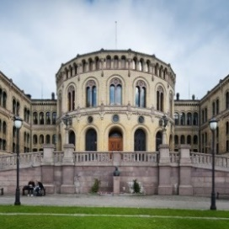


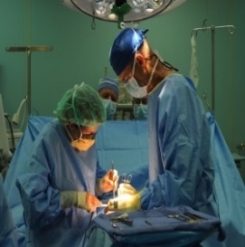
Seven areas of society
1. The labour market
3. User expectations
5. Living conditions
7. Political trends
2. Demographics
4. Technology
6. Health
Photo: Unsplash, Pexels and the Storting
Notes:
The Horizon Scan consists of these seven areas of society.

Slide 9

The labour market:
Faster restructuring pace
Photo: Pixabay, Colourbox, Pexels
Notes:
Introduction – The coronavirus pandemic has left lasting scars in the economy and the labour market, both here in Norway and in the rest of the world. Therefore, developments over the next few years will largely be characterised by recovery in the wake of the coronavirus crisis. However, in the longer term towards 2035, they underlying driving forces will be the same as in our previous Horizon Scan from 2019. However, we believe that in many ways, the coronavirus crisis will act as a catalyst that accelerates many of the processes we saw before the pandemic.

Slide 10

3 reasons for the high restructuring pace
Technological development
The green transition
A continued high level of globalisation
Photo: Pixabay, Coloubox, Pexels
Notes:
Technological development – Technology is constantly developing and leads to people changing job and updating their skills more frequently. The fear that jobs will disappear due to automation and digitalisation has long been present. The emergence of the sharing and platform economy provides new opportunities, e.g. in digital services, but also presents some challenges in meeting the Norwegian working life model.
The green transition – The consequences of the climate crisis are becoming increasingly evident and through the Paris Agreement, Norway has committed to cutting its greenhouse gas emissions in the coming years. We are currently not on track to reach the target of a reduction of around 50 per cent compared with the 1990 level by 2030, so the coming decade will probably be characterised by a comprehensive restructuring of the Norwegian economy. According to some estimates, the demand for oil has already peaked and we can expect less support to the Norwegian economy from oil-related activities in the years ahead. At the same time, new areas of opportunity will emerge within the new and greener economy, such as managing CO₂ emissions.
A continued high level of globalisation – Although there is a tendency towards increased protectionism in some parts of the world, even now during the coronavirus crisis, we still expect a high level of globalisation going forward. Digitalisation helps to erase geographical market boundaries. This presents challenges in the form of increased competition for many industries, but also major growth opportunities for Norwegian businesses.

Slide 11

The coronavirus is accelerating the restructuring
The coronavirus crisis has changed habits and preferences – are these changes permanent?
Crises accelerate change and innovation
A risk of more people remaining permanently outside the labour market
Norway depends on international developments
Photo: Shutterstock
Notes:
As mentioned, we think that the coronavirus pandemic will accelerate some of these processes in different ways.
Changed habits and preferences – The coronavirus crisis has forced numerous changes in our preferences and habits. We travel less, work at home, order food to be delivered to the door and shop more online. Tourism and air travel has been hard hit, while other industries have flourished during the pandemic. The question is how much of this will lead to lasting changes and thus have consequences for the labour market in the longer term.
Accelerates change and innovation – Crises like the one we are currently in also tend to accelerate change and innovation. A survey conducted by Computas shows that 8 out of 10 businesses have become more digitalised due to the coronavirus pandemic. Recessions and financial crises also tend to accelerate automation. Research from the US shows that the loss of routine jobs in the US in the past three decades is almost entirely linked to jobs that disappear permanently during economic recessions. There is considerable uncertainty about the proportion of jobs in Norway that risk being fully automated, but estimates from OECD indicate that around 6 per cent of the jobs in Norway risk disappearing and that just under one-third of all jobs will be significantly changed as a result of automation.
Risk of more people being permanently out of work – a high restructuring pace combined with a challenging future labour market also increases the risk of more people being permanently out of work. Digitalisation and automation are expected to affect low-income occupations to a greater extent, where the employees often lack formal competence. Many people have also expressed concern for young people with a weak labour market attachment. We also know that long periods of unemployment at a young age often have long-term negative consequences. In Norway, we also have a high proportion of people receiving health-related benefits sickness benefit, work assessment allowance and disability benefit. Previous research shows that the transition to health-related benefits also increases in periods of high unemployment.
Norway depends on international developments – As a small and transparent economy, Norway also depends heavily on what is happening in the world economy. As I mentioned earlier, the coronavirus pandemic has hit the world economy hard and although Norway has fared relatively well compared with other countries, we are dependent on what is happening in the world around us. The recovery in the international economy will require major public investments, while many countries are already struggling under high government debt that will make it difficult to finance the necessary packages of measures. This can slow down the economic recovery, which in turn will affect the Norwegian economy.

Slide 12
The composition of industry will change
Largest growth in service-providing industries and public administration
Weak development in the oil industry, manufacturing and the wholesale and retail trade
More people with higher education
Not everyone will find a job that requires this, especially in economics/administration, social sciences and humanities
Increased demand for nurses
Large shortage of vocationally trained workers – especially in health care and traditional trades
Employment according to industry. Thousand people
Source: Statistics Norway (Cappelen et al. 2020)
Notes:
The industry structure in Norway will also change over the next 15-20 years, and which industries will grow the most in the future will determine where employment will increase the most.
This figure shows the number of people employed in all the main industries (numbers in thousands). The dark blue columns show employment in 2019.
According to Statistics Norway’s projection of the development in the Norwegian economy and of the supply and demand for various educational groups towards 2040, which was published in November, employment will increase the most in the private service industries and public administration. As the light blue columns show, in 2040, there will be around 90,000 more people employed in each of these industries than in 2019. Much of the growth in public administration will be in health and care services due to the ageing of the population. Public administration and the private service industries, which include tourism and transport, culture, and commercial, professional and technical services, are already the largest in terms of the number of employees, and in around 20 years, will account for 60% of the employment in Norway.
After 2024, a significant decline in oil production and investments is expected, in line with the estimates from the Norwegian Petroleum Directorate and thus, employment will fall the most in the oil and gas industry. This industry is not so large in terms of the number of employees, but downsizing the petroleum activities will affect suppliers to the industry, and therefore, a decline in manufacturing employment is also expected.
A significant decline in employment is also expected in future in the retail and wholesale trade, mainly due to new trading patterns and increased e-commerce. While in building and construction, where there has been significant employment growth in recent years, only a modest increase is expected towards 2040.
According to Statistics Norway’s projections, there will be an increasing number of people with higher education in the future. More people will be educated in subjects such as economics/administration, social sciences and humanities than there is a demand for. These people will probably do well and find employment, but not everyone will find a job that matches their education. In addition, the lower birth rate will result in reduced demand for teachers in the long term, while a large shortage of nurses is expected due to the ageing of the population.
According to Statistics Norway, towards 2040, the greatest labour shortage will be in several types of vocational training, especially health care and programmes aimed at manufacturing, building and construction and traditional trades, which can be difficult to replace with people with higher education.

Slide 13

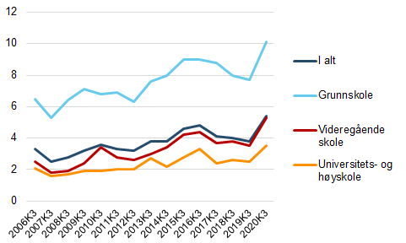
More than 1 in 5 do not complete upper secondary school
Nevertheless, the proportion who complete upper secondary education is increasing
Unemployment is highest among unskilled people:
Unemployment according to the level of education. Figures as a percentage
In all
Lower secondary
Upper secondary
University/university college
Source: Statistics Norway
Photo: Pixabay
Notes:
One of the reasons why Statistics Norway estimates a labour shortage in several types of vocational training is that currently one in five students do not complete their upper secondary education within five to six years. The drop-out rate is even higher in vocational subjects, especially among men, where one third do not complete the programme. On a brighter note, the drop-out rate has fallen slightly. Two years ago, when the last Horizon Scan was published, 1 in 4 did not complete their upper secondary education. If this positive trend continues, the shortage may be less than Statistics Norway estimates in its latest projection.
The drop-out rate from upper secondary education is a major societal challenge: For a long time, unemployment was clearly higher among those who had not completed their education or only had lower secondary education, as the light blue curve in the figure shows, and they are experiencing greater fluctuations. Among other things, the coronavirus pandemic has hit unskilled workers to a greater extent than other groups. Towards 2035, NAV expects this trend to continue and perhaps be intensified.

Slide 14

The consequences of automation and other restructuring
Possible periodically higher unemployment in particularly affected industries and occupations
New jobs come in other industries/occupations and can be created elsewhere in the country
NAV must facilitate restructuring – contribute to occupational and geographical mobility
Life-long learning and restructuring
NAV will be required to have more labour market and labour inclusion expertise
Notes:
All these factors will have several consequences for the labour and NAV.
Periodically higher unemployment in particularly affected industries and occupations – Due to the fast pace of restructuring going forward, we may experience several periods of higher unemployment in some industries and occupations or geographical areas, like we saw during the oil price fall a few years ago when unemployment rose sharply in Rogaland.
New jobs appear in other industries/occupations and can be created elsewhere in the country – Although many jobs will disappear or change content in the years to come, new jobs will appear. Calculations from the World Economic Forum indicate that the interaction between people, machines and algorithms on a global basis will create up to 12 million more jobs than those that disappear towards 2025. In addition, an ageing population will probably lead to a shortage of labour in health and care. We are thus in no way heading towards a jobless future just yet. However, the new jobs may appear in other occupations and geographical areas than those where the jobs disappear.
NAV must facilitate the restructuring – contribute to occupational and geographical mobility – Therefore, it is important that NAV helps facilitate the restructuring and contributes to occupational and geographical mobility, although this is a task that requires cooperation from several actors, including the education sector. There are also indications that geographical mobility can be less important in the years to come, as digitalisation makes it easier for many occupational groups to do their job without being physically present in the workplace.
Lifelong learning and restructuring – A key tool for increasing occupational mobility among job seekers is to facilitate skills development. In April 2020, the Government presented a white paper on the Competence Reform “Lifelong learning”. The white paper presented a number of measures to prevent any employees from becoming “outdated” due to poor training and lack of skills. This includes measures to stimulate more demand for skills development, opening the education system to lifelong learning and a better link between supply and demand for skills development. The establishment of a new programme for building skills to match the labour market has also been proposed. This will be a collaboration between the labour market and the public sector, both in terms of implementation and funding and new educational and training programmes will be developed to match specific and identified competence needs. This will include formal and informal training.
Increased requirements in NAV for competence on the labour market and labour inclusion – Finally, a fast pace of restructuring in the labour market will also require that NAV counsellors keep up to date on the local conditions in the labour market to be able to efficiently procure labour.

Slide 15

Demographics:
Weaker population growth,
stronger ageing
Photo: Colourbox
Notes:
The main picture here is that there will be weaker population growth going forward and even stronger ageing than we previously thought. A growing immigrant population and centralisation will continue to be important demographic trends.

Slide 16

Weaker population growth – stronger ageing
Consequences for NAV
Modest impact on workload – 3 in 4 NAV employees deal with people of working age
Recipients of old-age pension and assistive technology will increase by 40% towards 2035
Increased dependency burden – NAV will be expected to assist more groups towards employment
Photo: Unsplash
Source: Statistics Norway’s population projections, June 2020
Notes:
Statistics Norway has gradually lowered population growth in its projections.
In total, population growth is expected to be 7 per cent towards 2035, ½ per cent a year. In the previous 15 years, from 2005 to 2020, the population growth was 17 per cent.
As we can see, ageing will be extreme – a more than 60 per cent increase for the 75+ age group, while there is expected to be a decrease in the under 35 age group. Admittedly, the uncertainty is greatest here when it comes to birth rates (fertility rate) and immigration.
We see now that the direct consequences for NAV and our workload are fairly manageable. Most NAV employees are in contact with people of working age (we estimate that it applies to 3 out of 4 NAV employees) where the growth now looks to be very modest. Then, of course, there are other factors than demographics that will present challenges in the future – but here we are talking about demographics directly.
Some user groups will grow significantly - old-age pensioners and recipients of assistive technology – and this growth is expected to be more than 40 per cent in both groups towards 2035. Those who are already receiving an old-age pension often need little assistance from NAV and automation of this area has been a success. Assistive technology will present a major challenge should it become an area that requires almost 10 per cent of the employees in NAV.
We believe that the indirect consequences of the demographics will become increasingly more important. In particular, this concerns a higher dependency ratio (which leads to increased expenditure and reduced revenues over the state budget). We believe this will lead to even greater demands for rationalisation of the public sector. We also believe that it can lead to NAV being expected to follow up even more user groups than today towards employment – young people and the elderly, ranging from providing assistance to seniors in the labour market, to following up people on disability benefits and perhaps introducing an activity obligation for even more recipients of social assistance.

Slide 17
Old-age pensions and assistive technology increase the most
Recipients of NAV benefits and assistive technology, change 2010–2019 and 2019–2035
Source: NAV
Notes:
Here we see the development in the number of recipients of the most important benefits and assistive technology. The blue columns show the change from 2010 to 2019, the green columns show the expected growth towards 2035.
Old-age pensioners and recipients of assistive technology will be the user groups that will increase the most going forward – both by more than 40 per cent (45 per cent from 2019, but from 2021, this is around 40 per cent).
Old-age pensions: This is the total growth in the number of old-age pensioners. Since population growth will be greatest for the elderly, it means that the number of new people drawing old-age pensions will increase annually much less than this. Those who are already receiving an old-age pension often need little assistance from NAV. In addition, we have a high level of automation here and the most satisfied users. Therefore, the consequences are manageable. The exception will be for international cases, where cases still largely require manual processing. This will hopefully change towards 2035.
Assistive technology: This is an area that requires more personal service and assistance and where NAV currently does not have modern system solutions. User growth here will present far greater challenges as we are unaccustomed to such high growth in this area. The authorities also want elderly people to remain living at home for as long as possible and this can raise the need for assistive technology. Older people staying healthier longer can pull in the opposite direction. Technology is developing rapidly here – and it is hard to say what affect this will have. People over the age of 80 are the most frequent users of assistive technology. There has been weak population growth in this group, but there will be significant growth here when the post-war populations become recipients of assistive technology.
There will fairly moderate user growth going forward for the other benefits, such as disability benefit, parental benefit, sickness benefit, unemployment benefit and work assessment allowance for people under the age of 67.
The number of disability benefit recipients is expected to increase the most. We provide little personal assistance to that group today but continued strong growth may lead to political pressure that NAV must follow-up this group to a greater extent towards employment. Among other things, the Employment Committee has various proposals here.
Unemployment benefit – is difficult to predict in the long term – and will be based on growth in step with employment growth in the long term. However, we must expect significant fluctuations.
Work assessment allowance: There are several indications of weak development in the future, perhaps even a decline. This is due to several regulatory restrictions. This may provide the opportunity for closer follow-up of the recipients.

Slide 18

Lower growth and changed composition of the immigrant population*
* Born abroad of foreign-born parents
Photo: Aaron Thomas/Unsplash
Source: Statistics Norway’s population projections, June 2020
Notes:
How immigration and emigration will develop is probably the greatest uncertainty in population development. Very little news here in the last couple of years.
From around 2005 to 2015, there was record-high immigration. In the future, much lower immigration and high emigration are expected.
However, the immigrant population is still expected to grow by 22 per cent from 2020 to 2035, to almost 1 million in 2035, which is clearly lower than in the previous projection.
Three-quarters of the increase is expected to come in the lower group, from Eastern Europe outside the EU, Africa, Asia and Latin America. Most immigrants arrive in Norway from Africa and Asia.
There is a downward trend in labour immigration. This is due to stronger economic growth in Eastern Europe than here and that these countries have stronger ageing than us. Therefore, net immigration is highest among family immigrants.
Lower growth in the immigrant population may make it easier for immigrants to enter the Norwegian labour market.
The change in the composition probably results in a higher proportion of people who lack the right skills and work experience, and we see that more people than before lack basic education. This can pull in the opposite direction when it comes to successful integration.
This is an area where we know that the trend can turn abruptly, as experienced during the migrant crisis in 2015.

Slide 19
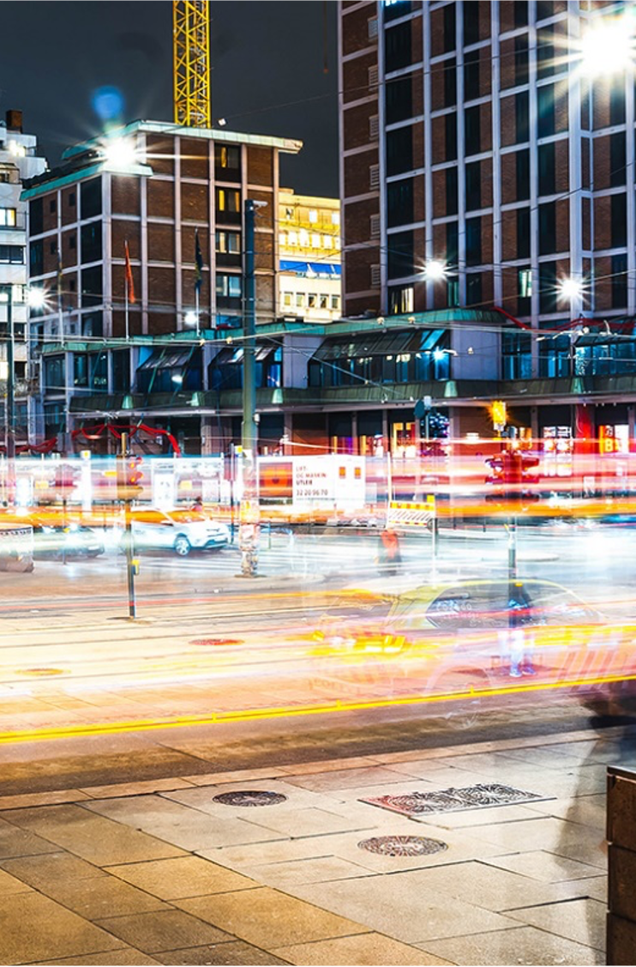
Centralisation continues – Increasing number of elderly in peripheral municipalities
Population growth 2021–2035 by the municipalities’ centralisation rate
(Population in millions in brackets)
Source: Statistics Norway’s population projections, June 2020
Photo: Erik Odin/Unsplash
Notes:
Here we see the population development for different groups of municipalities towards 2035 according to Statistics Norway’s division of the municipalities by centrality. We see that most of the municipal groups are expected to have population growth, except the least and second least central municipalities. There are significant variations here within each group. According to Statistics Norway, a decrease in the population is expected in 40% of the municipalities towards 2035.
One consequence is that these municipalities will have greater shortages of labour. It will also present a challenge for recruitment to NAV. Fewer people of working age will mean less need for many of NAV’s services locally. We think this will challenge our resources and how to ensure good enough knowledge environments and efficient resource utilisation. After all, digitalisation is pulling in the same direction.

Slide 20

User expectations:
Increased expectations for coordinated services and adapted service
Collage: Pexels/Skjermdump
Notes:
User expectations: In our previous Horizon Scan from 2019, we said that expectations will increase rapidly in the future - especially the expectations for coordinated services (both within NAV and across the public sector) and an adapted service (services much more adapted to the individual’s situation and needs). It is driven by the fact that people are experiencing a steady improvement in services elsewhere in society.
We think that Is very good. According to Difi’s population survey from 2019, 60 per cent say contacting public services involves a lot of hassle and irritation. This is up 13 percentage points from 2015. Public services have probably improved, but expectations have increased faster than the ability to meet them.

Slide 21

Expectations are shaped by other trends
Digitalisation leads to increased expectations
The labour market and the demographics change the composition and needs of the users.
Knowledge-based practice
Photo: Luke Chesser/Unsplash
Notes:
Our expectations for digital services, customer service and availability are largely shaped by what we experience in our daily lives.
In recent years, we have seen how digitalisation has provided the population and businesses with smart and efficient services at a rapid pace.
Surveys show that young people under the age of 30 are increasingly shaping their expectations for public digital services based on private actors such as Snapchat and Vipps (KMD 2018).
We believe that private digital services will shape the users’ expectations to a greater extent in the next 15 years and that NAV must follow this trend to make the services available and relevant.

Slide 22
Invisible, automatic and proactive services
The reuse of information and simpler processes for the users
In many areas, we assume that users will neither be in contact with us nor know that NAV is the provider of the benefit or service they are receiving
In 2035, I envisage that we will not have to struggle to receive the various services. That they will available to us where we live, when we need them.
User representative
In 15 years, I hope the system is so good that I as an ordinary user do not notice it.
User representative
Notes:
Digitalising services is about considering how the services can be improved and not just “electrifying” existing forms and processes.
The Digital Agenda for Norway (Meld. St. 27 2015–2016) (white paper) points to the reuse of information that we already have about users, which will save the users from having to submit the same documentation several times. Another example of how to simplify services for the users is to reverse the process so that the users are automatically offered benefits and services to which they are entitled, instead of having to apply for these
In many areas, we assume that in 2035, the users will neither be in contact with us nor know that NAV is the provider of the benefit or service they are receiving. OECD (Organisation for Economic Co-operation and Development) describes this trend as “invisible services”.
Although this can provide good services, we may face challenges.
An example is a growing scepticism to data sharing. One reason for this being a probable trend is an increase in services and businesses that use data. This in turn can lead to more cases of misuse, which we think will increase people’s scepticism. This may have consequences for the regulations on data security and protection of personal data and how we can use data in service development. Another possible consequence of this is that the users may have to make several choices when it comes to the protection of personal data, which may be perceived to be complicated and create uncertainty. The fact that users can also make different choices may also affect NAV in that the solutions become more complex to manage.
OECD also points out that one challenge with “invisible services” may be that the users will no longer understand the important role public services play and what they contribute to their lives (OECD 2020a). This can affect the understanding of and willingness to fund public services through taxes.
The road to invisible services does not build itself. What we achieve will depend on how we use the opportunities provided and factors such as regulations, ethics, competence and culture. The ability to understand and meet the users’ needs will be decisive, together with regulatory development, technological competence and innovation culture.

Slide 23

What knowledge do people need when in contact with public services?
Digital skills are a threshold today
People and businesses often face demanding situations that affect how they use our services
Administrative competence will be important as long as the services are complex and not well coordinated
Can automation make us less aware of our rights and obligations?
Photo: Unsplash
Notes:
The majority of the population in Norway have good digital skills. In 2017, 3 per cent of the population had no digital skills, while 22 per cent had poor digital skills (SSB 2017). In 2035, we believe these groups will be significantly smaller. However, it is important to ensure that our services are also available to these users. In January, check if new figures have been received from Kompetanse Norge.
While we must facilitate for those who have no or poor digital skills, we believe that digital services will steadily improve, and that people will be better at using them. We also believe that in the years to come there may be other skills that affect the extent to which people benefit from digital, public services, such as knowledge of the public sector (often called administrative competence).
It is difficult to envisage what skills employees will need in 15 years when providing public services. Automation may mean that digital skills and administrative competence are less important. At the same time, automation will create new problems. For example, the user may be less familiar with public services and regulations when they do not have to use them. This in turn can affect the ability to verify whether the users are receiving what they are entitled to. Verne (2015) shows how young people who have not filled out a tax return understand less than older people about what happens when they fall outside the current automatic tax process.

Slide 24
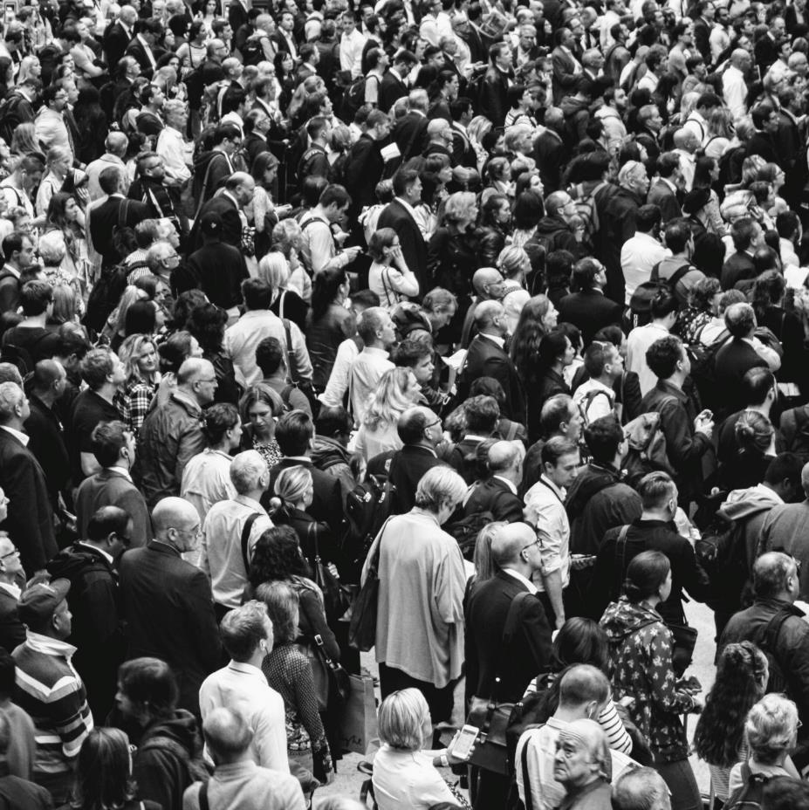
Adapted service and coordinated services
Services tailored to the individual’s situation and needs
Get the help I need, when I need it
Able to make your own choices to a greater extent
Do not have to deal with how the public sector is organised
Will NAV become more of a data provider?
Photo: Rob Curran/Unsplash
Notes:
Adapted service
Putting the needs of the users at the heart of the development of services has been an objective for some time and we believe it will become even more evident over the next 15 years. The trend is largely about people expecting analogue and digital services tailored to their specific situation and needs. The Digitalisation Council (2020) points out in its experience report from 2020 that it is not enough to put users at the heart of the developments, we must also think like the users. By that, we mean that we must put ourselves in their situation when they need a service. The NAV user representatives describe the same thing when they point out that we must create “packages” for the users based on their needs. The Government’s Digitalisation Strategy (The Ministry of Local Government and Modernisation 2020a) is based on the principle “the user at the heart of development” and points out that digital services should be based on life events to coordinate the services better.
In 2035, we believe that users and businesses will want to choose how they will contact NAV and what kind of help they will receive. In both of the major user groups, there is a diversity of needs and expectations that must be met with adapted service. For example, today we see that smaller businesses, to a greater extent than the large ones, expect NAV to be a kind of HR department, while larger businesses have their own resources to deal with the contact with NAV. We believe that most people want digital and automated services. Through the use of data and more user-centred services, we believe that most people will experience our digital services as being tailored to their needs. However, other people will want a tailored and individual service through receiving assistance from a NAV counsellor and at the same time expect this service to be readily available.
Coordinated services
To gain access to public services today, people and businesses must largely understand how the public sector is organised and who is responsible for what services. The expectations for coordinated services concern the services for which NAV is responsible and other public services. We believe that technological developments can help the users to receive better and more coordinated services.
We see that personal users and employers want more coordinated services from NAV (Nyberg et al. 2020). Coordinated services also means being able to contact NAV without being familiar with our internal organisation. When the users are contact with NAV today, they are not free to choose the channel they want. For example, people need to use different channels for queries about benefits and follow-up, respectively. The reason for this is that we have specialised areas to provide the correct answers, good quality of service and efficient operations. In other words, we try to direct inquiries to the units that have the appropriate expertise to meet the needs of the people. Going forward, users will expect the same service and expertise in all channels.
Data provider
The expectation of not having to deal with NAV and the bureaucracy of the public sector may also encourage actors to provide services where the users already are.
NAV can allow other actors to use our data to provide services and use data from others in our services. NAV currently uses data from private solutions such as Finn.no to provide the service at “arbeidsplassen.no”, which presents job vacancies from many sources. NAV also collects data from partners, such as organisers of labour market measures or the health service. It is difficult today to estimate how much this trend will increase over the next 15 years, but we have seen several instances where this form of data sharing has provided improved services to the users. Therefore, we assume that we will see more examples in the years to come. The consequences for NAV may be that in several areas we assume the role of data provider rather than service provider.

Slide 25

Meetings that help people to move on
Automation will take away many of today’s meetings
This will increase expectations for the services and the contact with NAV
Move on in life, away from the situation you or your business is in
Applies regardless of whether the meeting is with a person or a machine
May change the expertise NAV requires
User needs
Relationships
The labour market
Photo: Stock photos
Notes:
In 2035, we assume that more of NAV’s services are automated and are in many ways invisible. At the same time, we believe that users will gain even greater knowledge and expertise on how they can help themselves through available information and tools on the internet. This can change the expectations people have for their contact with NAV. This applies regardless of whether the meeting is with a person or a machine.
Firstly, this development may lead to higher expectations that contact with NAV will help him or her to move on in life or from the situation that made him or her or the business need help. We assume that these expectations will be more about relationship building, motivation and supporting the user. This is important expertise among the NAV counsellors today and can be even more important in the years to come. The need for expertise can also develop more towards coaching, psychology and other expertise required to help people move on in life and at work. In many ways, this development is similar to the one we expect within care professions. One of the reasons for the focus on welfare technology is that those who meet the users and patients shall be able to spend more time on care and support where this is needed the most (NOU 2011:11).
Secondly, we believe that NAV will be expected to have good knowledge of the labour market and be able to help people and businesses. We also believe there will be heightened expectations for this knowledge. The internet already gives people access to information and knowledge that enables them to ask more difficult questions when in contact with professional expertise in several sectors. An example is how today you can read up on symptoms and medicine before meeting your GP. We believe this trend will be reinforced by more information being available in better ways on the internet.

Slide 26

Technology:
Data-driven
services
provide great
opportunities
Photo: Pexels
Notes:
Technology
This chapter will primarily discuss digital technology development and the opportunities it can provide to NAV
We are in the midst of a pervasive digitalisation of the whole society.
The exponential growth in data we see in all areas of society, including NAV, provides us with significant innovation opportunities within data-driven services.

Slide 27






Rapid technological development Several trends will affect lives and societies
The green transition
The physical and digital are merging
Robotised and driverless
Personalised medicine
Photo: Daniel Morris on Unsplash
Notes:
The only thing we can say with certainty is that we are living in a time of rapid technological development. Development is fast and we are embracing new technology faster than ever but it is not easy to predict the path it will take.
If we look towards the horizon, we will glimpse the contours of some major trends that will affect life, work and society in the years to come.
We are facing a green transition – where technologies such as sun, wind, etc. will undoubtedly play an important role
The physical and the digital are merging: We already see this development in new cars, which are equipped with sensors, a computer and are online. New cars produce data which are used to improve the design and make new cars – or even other things, better…
Agricultural robots will probably sow and harvest and perhaps even a self-driving ferry will transport you to work in the morning.
Treatments adapted to the biological conditions of the individual patient allow for more detailed diagnoses and courses of treatment tailored to individual needs.
Perhaps we are even seeing the beginning of a whole new space age.
All this, and more, will be important and in different ways will affect life, society and work in the years to come, but there may be one particular trend that takes hold across all this and more – across all industries, sectors and areas of activity.

Slide 28




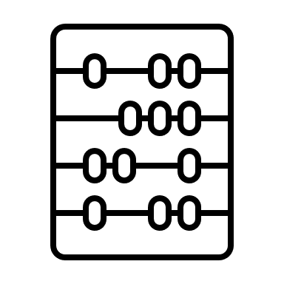
Digitalisation continues to spread Persistent and growing trends
Quantum computers
The Internet of Things
Cloud services
Artificial intelligence
5G
Digital twins
Cheaper and more flexible computing power
Broader and easier access to data
Algorithmic systems
All photos: Unsplash
Notes:
Namely that the world is becoming more influenced by how data is produced, collected, analysed and converted into services and production.
This in itself is nothing new - it has been happening for several years now, but there are no signs that this trend will subside in the years to come:
At least three coinciding factors that reinforce each other are expected to give the development increasing weight and power in the years to come:
The underlying driving elements are unchanged, although there may be new technologies that make their mark:
Cheaper and more flexible computing power: Cloud services are already enabling small start-ups to gain access to the same computing power as large companies. NAV and other public actors are now taking their first steps into the cloud. And although it may still be a curiosity at the moment, you can now purchase computing power from quantum computers from the major cloud providers. As this technology matures, as significant improvement in performance and power is expected.
Broader and easier access to data; we are using technology more than ever, and producing more data than ever before. There is no reason to believe that this will subside: the 5G network is now being rolled out in the whole country – erasing the distinction between the fibre and mobile networks– and not least allowing new devices to come online – sensors from cars, bicycles, power plants and even shopping carts in REMA supermarkets – all of these are online and producing data that can be used to develop new goods and services.
And while everything creates a digital data shadow, we are constantly seeing new tools/techniques to make wider use of such data or using it in new areas - we can perhaps create a digital twin of the car that can be used for testing and development? Perhaps artificial intelligence in its widest sense can be used to create personalised advice and recommendations or even drive you home late at night. (Forgot your key, don’t worry – the door opens by image recognition.)

Slide 29
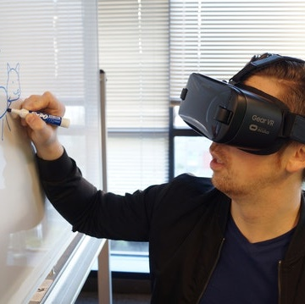
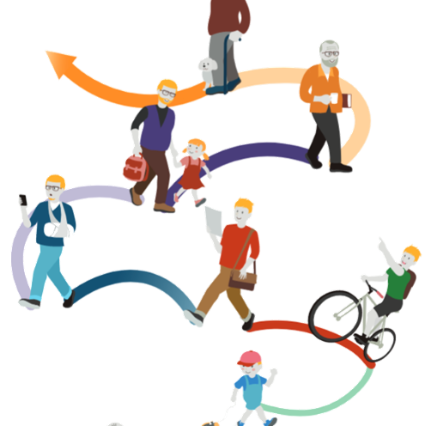

Digitalisation trends in NAV Persistent and growing
User contact is digitalised
From online self-service to the digital NAV office.
The administration is digitalised
More tasks are solved digitally and as coherent services around life events.
Ethical and sustainable digitalisation
Broader debate about protection of privacy, algorithms, rule of law, power and the use of data.
Photo: Pexels, Colorbox
Notes:
What does all this mean for NAV?
We should be careful about predicting with certainty, but also here we see tendencies and trends that we do not think will subside soon – rather the opposite.
User contact is digitalised: Nothing new: we are already well on our way to facilitating increased self-service online and this will continue. But what about NAV office? Will it remain and if so, what will it look like in 15 years? Some signs may give us an indication:
We see courses and educational programmes appearing on platforms such as Coursera and EdX. Here you can take online courses in everything from gastronomy to finance and programming. You can take short add-ons or a whole degree. When it suits you, where you are and adapted to your needs. And these services are geared towards a changing labour market, where continuous learning, professional training and reorientation will probably become increasingly important.
The coronavirus pandemic sent public services such as doctor consultations and school lessons onto digital platforms almost overnight. Also in NAV, some services were offered on digital platforms for the first time. We have found that opportunities exist and some solutions are probably here to stay.
Our youngest users in 2035 are currently attending childcare centres. They are growing up in a world where you can choose when and where you want to watch your favourite series, find it completely natural to use your mobile to shop online and where your social life is lived just as naturally on a digital platform as in the physical world.
In the future, it is not inconceivable that job seekers can receive guidance and adapted services without visiting a physical NAV office, for example, by allowing job seekers access to tailored work-related courses on digital learning platforms, run video meetings with a counsellor from your kitchen table and perhaps even receive individually tailored practical job training at home via a VR headset. (When NAV Office is digitalised in this way, it will place other demands on supervisors and the relationship with the users.)
The administration is digitalised → around life events and situations.
Adaptation: The said tailored course packages. Users of Spotify and Netflix are used to being greeted by content tailored to their preferences and needs. It is not inconceivable that NAV will draw inspiration from this development based on the user’s life events and situation. Services that are adapted to individual needs. Here, in interaction with AI, data can also be used to provide different forms of support in everyday life.
Nudging: digital platforms can influence behaviour and provide exciting opportunities in, for example, the prevention of sickness absence in the workplace or help job seekers find employment.
Decision-making support: For NAV, it is also possible that counsellors can receive advice about which people should be given priority for follow-up and an unemployed person can receive more personalised advice about which jobs he or she should apply for or which educational measures will improve his or her job prospects.
Platforms: Digitalisation also provides new opportunities for interaction: digital platforms such as Finn and AirBnB do not offer goods or services directly but make it possible for different actors to find each other. In many areas, NAV is also such a coordinator, whether it is between employer and employee or course provider and users. Moving this interaction to digital platforms may provide opportunities for other actors to innovate and develop services for our users.
The possibilities are endless, but we also see that new and demanding challenges follow in the wake of new technology. Different forms of cybercrime will increase in strength and frequency.
Hand-in-hand with a more focused debate that sets clearer requirements for what we call “ethically sustainable digitalisation”:
The possibilities for automation, adaptation and recommendations assume the use of data in ways that may challenge regulations and protection of privacy (we have seen examples in the wake of the coronavirus restrictions), but we are also seeing more concerns related to discriminatory and unexplained algorithms,
Digital echo chambers, fake news and technological tools that are used consciously and inadvertently to polarise opinion present new challenges for democracy and social debate, while technology alters power structures and raises difficult questions about regulation and autonomy.
Several sources expect the debate and user expectations related to ethically sustainable digitalisation to heighten.
As the most important actor in welfare, it will be particularly important for NAV to have an ethical and responsible approach to all digital technology with a broad anchoring and acceptance in the population.

Slide 30


Eliott Reina/Unsplash
Living conditions:
Photo: Igor Cancarevic/Unsplash
Stable purchasing power
Young people and immigrants most at risk of having low incomes
Restructuring can increase the differences
Eliott Reina/Unsplash
Notes:
Now over to living conditions. Living conditions are about material living standard, about access to housing, transport, food and clothes. Purchasing power is an important indicator of the kind of living conditions households can achieve. Norwegian households have had a stable purchasing power since 2013, while in the preceding decade, low-income households also experienced a growth in purchasing power. In the period from 2013 to 2018, there has been an increase in the proportion of the population with relatively low incomes, which means that there has been a rise in income inequality. Young adults and some immigrant groups are more at risk of having low incomes. The restructuring of the labour market will affect low-income groups more than others and may also contribute to greater income inequality towards 2035.

Slide 31
Increased income inequality
Restructuring in the future may increase income inequality
Households with immigrants (particularly with a refugee background) often have low incomes
1 in 3 immigrants from Eastern Europe, Africa, Asia and Latin America
The growth in the proportion of immigrants is the reason for the growth in low incomes
A high level of social mobility among descendants of immigrants
Source: Statistics Norway
Notes:
The figure you see here shows the development in so-called persistent low income, which is a relative measure of the risk of poverty according to the EU definition. This means that the household has an income below 60 per cent of the average income in Norway over a three-year period, and where the number of children and adults in the household are taken into account. Students are a group that often have low incomes, but they have not been taken into account in these figures.
The proportion of the population with low incomes has increased since around 2010 (red curve) and unfortunately, we think that the proportion of low incomes will also increase going forward. Technological developments and a continued high level of globalisation will make it harder for vulnerable groups in the labour market. The aftereffects of the coronavirus crisis are pulling in the same direction. Admittedly, this will depend on how well we succeed in meeting the restructuring going forward.
Immigrants are strongly overrepresented in the low-income group. This is especially true among refugees, and analyses from Statistics Norway (SSB 2020) show that much of the increasing income inequality can be explained by an increased proportion of immigrants. Among immigrants from Eastern Europe, Asia, Africa and Latin America, around 1 in 3 of the households have persistent low incomes.
And the main reason for an increased number of low incomes is that there was a high level of immigration in the period and that many refugees with family have arrived in Norway. Refugees and reunited families are often outside the labour market in the first few years after arriving in Norway, but employment increases when they have been in the country for a few years.
One positive factor is that there is a high level of social mobility among the descendants of immigrants.

Slide 32
Increasing income inequality
A sharp decrease in the proportion with low incomes in the 67+ age group
A significant increase in the proportion of young people (18-34 years) with low incomes
Source: Statistics Norway
Notes:
The figures shows the development in the proportion with low incomes for the various age groups.
The proportion is highest among young adults aged between 18–34 years. This is mainly due to employment decreasing slightly among young people. We can also see this in context with the high proportion of people who do not complete upper secondary education.
Among seniors aged 67 years and older, on the other hand, we see a strong decline in the proportion with low incomes.
Keeping in mind that a persistent low income is a relative poverty target, Statistics Norway also has other indicators, including the proportion of the population that are materially and socially disadvantaged. This proportion has remained at a relatively low level in Norway in recent years. There has also been significant growth in real income for all income groups, including those with the lowest income. From 2012 to the present, real income has admittedly stagnated for the 20 per cent with the lowest incomes.

Slide 33
Little relationship between persistent low income (EU60) and the need for social assistance
Consequences for social services in NAV
Increased income inequality does not necessarily mean an increased need for social services from NAV
The number of refugees with a short period of residence has a clear correlation with the demand for financial social assistance
Source: Statistics Norway
Notes:
This figure shows that although income inequality has increased in the last decade, the proportion of people receiving social assistance has remained stable and has decreased in the last 20 years. We also see that there is no connection between the individual groups. Persistent low income has increased for young adults (18-34 years), while there is no corresponding increase in the proportion of recipients of social assistance.
Increasing income inequality is a societal problem – and what to do about it is a political issue. However, if income inequality continues to increase it is not given that it will have major consequences for NAV, at least not for social services. State social security benefits may increase as a result of more people remaining outside the labour market – if that is the reason for increased income inequality. However, in the last decade, we have seen increasing income inequality without an increase in social assistance or health-related benefits.
It is especially among refugees with a short period of residence that there is a high proportion of recipients of social assistance. There is reason to believe that the future development in the number of recipients of social assistance will be affected by the number of refugees that arrive in Norway, as well as to what extent newly arrived refugees are integrated into the labour market.

Slide 34
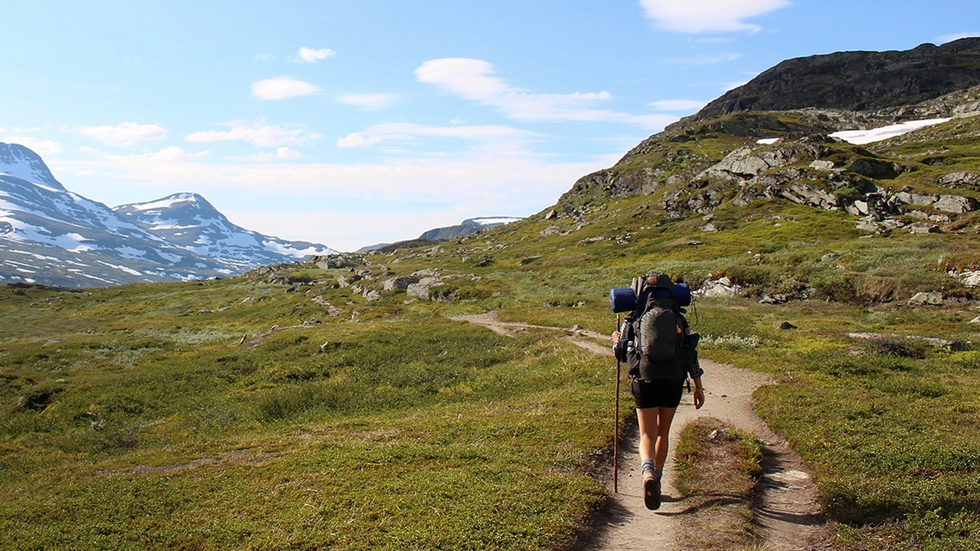

Health:
Photo: Juliane Liebermann/Unsplash
We are becoming healthier and living longer
Photo: Igor Cancarevic/Unsplash
Notes:
The topic is now health and I will talk a little about public health in general and about the use of health-related benefits. I will finish off by discussing how the coronavirus pandemic affects these areas.

Slide 35





Norway is among the best countries in the world in terms of public health and we are becoming healthier
Life expectancy
Life expectancy
Source: Statistics Norway and the World Health Organisation
Notes:
Our main message here is that we are getting healthier and living even longer.
According to the World Health Organisation (WHO), Norway is among the best countries in the world in terms of public health.
A common measure of public health is how long we live. Life expectancy in Norway has grown steadily and is expected to continue to grow at the same pace in the future. For several decades, we have also seen a similar increase for healthy life years, which is a measure of how many years of life we are in good health.
(New figure) The increase in life expectancy has been stronger than in our neighbouring countries. Norway has now caught up with Sweden and Iceland, where the population has had a longer life expectancy than us.
However, some risk factors threaten the progress in public health, such as the increased use of drugs and an increasing proportion of obese and overweight people. The developments in health technology and medical research pull in the opposite direction. The latter has perhaps been the most important development so far and there is no evidence that the use of drugs and an increasing proportion of obese and overweight people have affected life expectancy to any extent. Smoking is another risk factor. However, the proportion of smokers In Norway has decreased sharply since 2000, when around one in three adults smoked daily, to every tenth adult in 2019. As in the other Nordic countries, there are relatively few daily smokers in Norway today.
When it comes to mental health disorders, most studies that compare the incidence of mental health disorders in the population over time find no increase. One exception here is for young people aged 16–24 years, where an increasing proportion of young people are suffering from mental illness. It is unclear to what extent the development is due to objective changes in health and to what extent it is due to greater transparency about mental health disorders or an increased tendency to diagnose complex problems.

Slide 36

Fewer receiving health-related benefits
Proportion of the populated aged 18–66 years who are receiving health-related benefits*
Decrease from and including 2010
Largest decrease among the oldest, a slight increase for those under 30
Still high numbers – but fewer people in Norway than in other countries who are not in employment and education
Expect a stable development towards 2035
Risk factors/NAV’s role:
Pace of restructuring in the labour market
Increased pressure on low-skilled occupations
Dropout rate in upper secondary schools
* Health-related benefits are disability benefit, work assessment allowance and sickness benefit
Photo: Unsplash
Notes:
We will now see how public health can be translated into the use of our health-related benefits.
Here we see statistics for the proportion of the population aged between 18 and 66 years who receive health-related benefits – i.e., either sickness benefit, work assessment allowance or disability benefit.
What we see is that there has been a positive trend in recent years – the proportion receiving these benefits has fallen every year since 2010. At the end of 2019, bare 17 per cent of the population aged between 18 and 66 received such benefits.
Important explanations for the decline include better health and a higher level of education in the population. The decline in health-related benefits has been the greatest for those over 60 and improved health is probably a particularly important explanation for this.
Other explanations are the pension reform from 2011, as well as increased focus on activity requirements related to benefits and more contact with the workplace during the period of illness.
There has been a decline in all age groups, except for young people under 30 years of age. There has been a stable development among young people, but there are more people receiving disability benefits and fewer receiving sickness benefit and work assessment allowance (AAP).
A particular concern is that the number of people receiving health-related benefits has increased for those under the age of 20. One hypothesis to explain this here is that more premature babies survive and we also see that more children than before are born with deformities. Some of these struggle with delayed injuries in adulthood.
Excessive use of health-related benefits can lead to a risk of what we call medicalisation, which means that a diagnosis is given and a medical stamp is put on complex problems that involve health and other underlying reasons why the person concerned cannot return to work, such as dropping out of school, social problems or substance abuse. Research shows that this medicalisation may do people a disservice and lead to fewer people returning to work in the long term.
Towards 2035, we expect the proportion of the population receiving health-related benefits to remain stable. Continued improvement in health, despite the coronavirus, will contribute to a decline, but there will be increased ageing in the target group for these benefits that pulls in the opposite direction.
There are also some risk factors we need to be aware of that can lead to the trend reversing. It is a lot about how well Norway succeeds in managing the restructuring pace in the labour market and further reduce the number of students dropping out of upper secondary school.
We know from experience from previous restructuring, including the oil crisis in South-West Norway, that not only does it lead to higher unemployment but also to a rise in the number of people receiving health-related benefits, which in turn leads to the risk of more people remaining permanently outside the labour market.
When it comes to students dropping out from upper secondary school, there has been a positive trend in recent years with a larger proportion managing to complete their education. However, there is still much to do and many of these people will struggle to enter and stay in the labour market.
NAV’s role in this will also be important in the future so that we can help ensure that as many young people as possible manage to stay in the labour market. This must be done in close cooperation with the education sector.

Slide 37
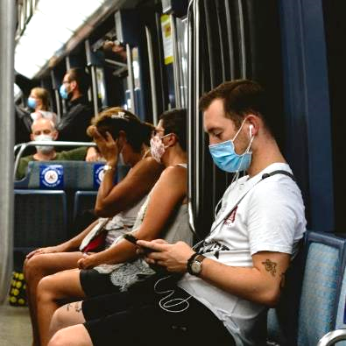
How does the coronavirus pandemic affect public health?
An immediate increase in sickness absence (Nossen and Sundell 2020)
Unknown long-term effects
Direct effects of the disease
Indirect effects of the measures
Figure: Weekly mortality rate (per 100,000) in Norway and Sweden.
Compare 2020 with the average in the period 2015-2019.
(Source: SSB, Socialstyrelsen and Fiva, 2020)
Photo: Unsplash
Notes:
The effects of the coronavirus pandemic can be divided into direct and indirect effects. The direct effects come from actually having had the illness. In an article in the magazine “Arbeid og velferd”, Nossen and Sundell (2020) showed that sickness absence increased immediately after the coronavirus arrived in Norway in March 2020. Sickness absence remained high throughout 2020.
The number of deaths from the coronavirus have so far not been particularly high in Norway. In the figure, the blue line shows the weekly mortality rate in Norway last year compared with the average in previous years. We see no indications of higher mortality due to the coronavirus. The green line shows the corresponding statistics for Sweden, which has been harder hit by the coronavirus pandemic. There we see that the weekly mortality rate was clearly higher from March/April but then fell to the average after a few weeks.
The long-term effects of having had the coronavirus are uncertain. There have been indications that some people experience impaired health for a long time afterwards. This may in turn lead to long-term receipt of health-related benefits and retirement from working life.
The indirect effects are also uncertain and may be due to the measures associated with the pandemic. Unemployment has been high at times and we have previously seen that cyclical downturns lead to an increased number of people receiving health-related benefits. We have also seen signs that the pandemic and the social lockdown has led to an increasing tendency for there to be more people with mental health problems. This in turn can lead to more people with health problems and receiving health-related benefits.
In conclusion, we expect a further positive development in public health going forward. We believe this will provide a stable development in the number of recipients of our health-related benefits, despite the pandemic and other risk factors.

Slide 38
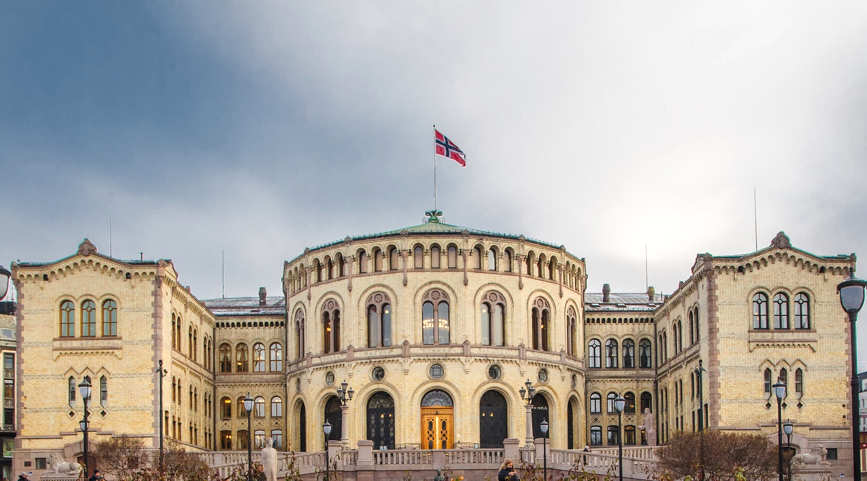
Political trends:
Photo: The Storting
Restructuring, labour inclusion and the sustainability of the welfare state
Notes:
The main goals of Norway’s labour and welfare policy are a well-functioning labour market with a high level of employment, financial and social security and a safe and professional labour market.
We believe the three most important political challenges ahead of relevance to NAV will be restructuring and new skills, inclusion of vulnerable groups and ensuring the sustainability of the welfare state.

Slide 39

Restructuring, inclusion and sustainability
Restructuring and new skills will become increasingly important
Inclusion of vulnerable groups
Some groups of immigrants and young people with a lack of formal competence
Ensure the sustainability of the welfare state
Balance between secure welfare schemes and financial sustainability
Tough priorities require combinations of different measures, depending on the political majority:
Reduce spending?
Increase tax revenues?
Increase employment?
Rationalise the public sector?
TO BE REPLACED
Photo: Colourbox
Notes:
In recent years, the skills policy has been high on the political agenda.
A national skills policy strategy has been adopted to ensure competitive industry and commerce and an efficient and well-functioning public sector. A competence reform for “Lifelong learning” has also been proposed, where one of the measures is a skills development programme aimed at industries with many skilled and unskilled workers.
We know that digitalisation and the green transition reinforce the demand for new and up-to-date skills and that many people will find their work tasks and job content changing and possibly becoming automated.
Political steps to ensure the necessary restructuring will then become even more important going forward.
Restructuring and a skills boost will also help prevent social exclusion and exclusion from the labour market in that people have the skills to match the labour market.
This applies especially to vulnerable groups, such as some groups of immigrants and young people with a lack of formal competence.
Immigration requires integration and training, where better and earlier access to an upper secondary school education and trade certificates can be relevant measures.
To capture young people at risk of being permanently excluded from the labour market, relevant measures will be to make it easier to access apprenticeships and provide closer follow-up.
Another key political challenge will be to balance secure welfare schemes with economic sustainability.
Politicians face tough priorities here:
One option is to cut expenditure through fewer or lower welfare benefits and/or a reduction in services.
Another option is to raise taxes.
A third way is to increase labour market participation and thereby tax revenues.
A fourth option is to rationalise the public sector.
Political parties have different views of which instruments are best suited, but it is difficult to avoid combining several instruments due to the challenges being so great.
Any economic shock scenario, for example, triggered by a sharp and permanent fall in oil prices will make these measures even more pressing.
This will significantly affect NAV, either through increased demands for nationalisation, that we are challenged to a greater extent to follow up more user groups towards employment or whether there will be more rule changes relating to benefits in the future. All this is probable.

Slide 40
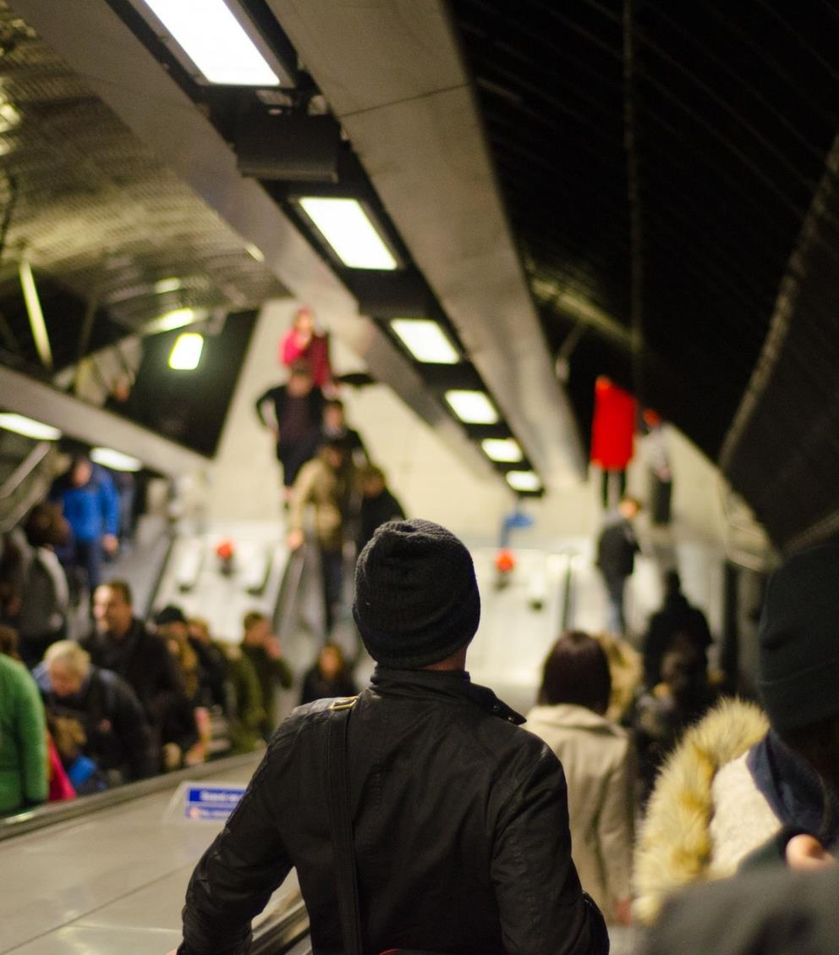
Important lines of conflict going forward
In the labour and welfare policy
Public vs. private solutions
Universal vs. selective schemes
Whip vs. carrot
In society as a whole
Climate and environment
Immigration and integration
Centralisation
Globalisation and international cooperation
Increasing polarisation internationally – for the time being a high level of trust in Norway
TO BE REPLACED
Photo: Pexels
Notes:
The Norwegian labour and policy will be characterised by stability and cross-party agreement on fundamental aspects.
Nevertheless, there are some lines of conflict that may become important going forward.
The first is that tighter economic frameworks will amplify the debate about public or private solutions. In the population, there is growing scepticism towards the privatisation of public services, while many people are positive to private welfare services being a supplement to public services.
The second is that different forms of means-testing and self-funding may be placed on the agenda. An activity obligation or part-time work in combination with benefits may be introduced. Cuts to sickness benefits may also become a topic of debate.
Universal schemes are less resource-intensive to manage. Political micro-management, securing rights for individual groups to a greater extent may be pushed through by politicians who feel the need to “put matters straight” in individual cases.
The third topic is the relationship between “whip” and “carrot” to boost employment. It is about the balance between incentives and distribution. There will be political disagreement about how high benefits can be without these leading to too many negative work incentives.
/*/
The labour and welfare policy will also be affected by other policy areas. This applies not least to climate and environment, where the green transition will require major restructuring. Here, NAV will be affected by political decisions to facilitate restructuring and by how industry and commerce seize opportunities.
In the field of immigration and integration, the debate is often about the extent of immigration, integration measures and what requirements to set in different areas. There are several political paths here, both in terms of labour immigration, receipt of refugees and integration. These will affect NAV going forward and require coordination with other actors.
With increased centralisation and an elder boom hitting the regions the hardest, there are many indications that the centre/periphery will continue to be a key line of conflict. The discussion here revolves around basic welfare services linked to regional policy, where municipal mergers and centralisation of NAV offices can become key areas of contention. At the same time, digital services have made geographical distances less important.
Another important policy area is international cooperation. As a small and transparent economy, Norway has benefited from the internationalisation that has taken place in the last few decades. Relations with Europe will probably be more important going forward and we have the misinterpretation of the EEA rules still fresh in our minds.
/*/
Internationally, decreasing political trust, increasing polarisation and populism have been much-discussed phenomena in recent years. Our welfare model is largely based on trust.
These are currently limiting factors in a Norwegian context, partly due to well-developed welfare schemes, tripartite cooperation in the labour market and that we have a multi-party system.
The coronavirus crisis has so far shown that trust in the authorities and politicians is strong and that political compromise and cooperation are the main rule.
At the same time, high unemployment, greater inequality and a sharper tone in the debate can lead to increased polarisation and less trust even in Norway.

Slide 41
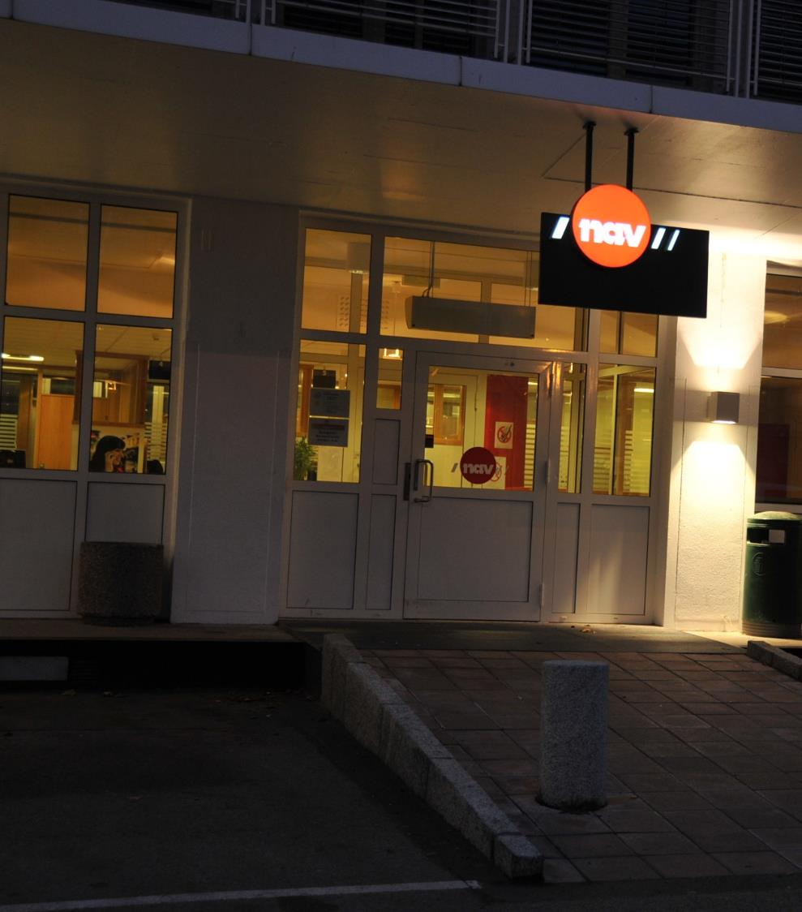
Political opportunities
Restructuring and skills development measures
NAV, employers, employees and politicians are responsible
Greater emphasis on education as a labour policy instrument
Increased interaction and coordination
Requires regulatory amendments and removing organisational barriers
A new Public Administration Act allows for more interaction
Digitalisation and simplification
Aim for more comprehensive user experiences when in contact with the public sector
Digitalisation and automation require simplification of the regulations
TO BE REPLACED
Photo: NAV
Notes:
The expectations for NAV going forward are that we provide services that facilitate restructuring and skills development and promote mobility in the labour market.
It has become possible to combine unemployment benefit with education during the coronavirus crisis and combinations of social security schemes and skills development may also be a probable policy in the future.
Another expectation for the public sector is improved coordinated services because the users expect this and because societal challenges have widespread effects. To achieve this, regulatory amendments and removal of organisational barriers will be necessary. In the proposed new Public Administration Act, cooperation between administrative bodies is an important topic, and certain relaxations in the duty of confidentiality have been proposed to make interaction easier. At the same time, increased interaction will depend on political will and governance.
Increased interaction also goes hand in hand with digitalisation.
Simplifications and adjustments to the regulations are then often required. Although complex rules can be automated, this is often more resource-intensive.
Simpler rules are also easier for the users of the services to understand. At the same time, simplifications will sometimes have negative consequences for some and there will often be the political desire for greater flexibility and more targeted benefits. There may be circumstances that make it difficult to make simplifications.
Finally, let me sum up by saying that regardless of the political majority, labour and welfare policy will primarily be influenced by major societal trends elsewhere. Therefore, the main picture is that politicians will provide assistance to meet the challenges of the future, both in terms of restructuring, inclusion and to ensure a sustainable welfare system.

Slide 42







Main findings
Digitalisation is spreading – more flexible computing power, broader access to data
Data-driven services provide great opportunities when digitalising user contact and administration:
Automation, adaptation, decision-making support, nudging
Digital platforms where other actors can develop services
Protection of privacy and social acceptance considerations give increased ethically sustainable digitalisation requirements
Faster restructuring pace – technology, continued high level of globalisation, green transition. The coronavirus pandemic will accelerate restructuring
1 in 5 do not complete upper secondary school
NAV must facilitate restructuring and contribute to increased mobility
Need for better cooperation models with employers and across sectors
Labour market
Technology
Weaker growth than expected – ageing, immigration and centralisation still the most important factors
Weak growth in services and benefits to people of working age, 40 per cent user growth in assistive technology will challenge NAV
Lower immigration can ease integration, a changed composition pulls in the opposite direction
An increased dependency burden may lead to increased rationalisation and work-related follow-up
Increasing income inequality, young adults and some immigrant groups most at risk
Increased life expectancy and better health, but high restructuring pace increases the risk that exclusion from the labour market can increase
Demographics
Living conditions and health
Photo: Pexels, Unsplash, the Storting, Colourbox and Pixabay
The most important political challenges: Restructuring, inclusion and the sustainability of the welfare state
Lines of conflict going forward: Public vs. private solutions, universal schemes vs. more means-testing, whip vs. carrot
Rule changes that support digitalisation and increased interaction
High level of trust and political stability prevail in Norway although political polarisation is an international trend
Expectations are increasing faster in step with services elsewhere in society – especially coordinated services and an adapted service
Increase user meeting requirements – professional advice, relationship skills
User expectations
Political trends
Unexpected events require the ability to quickly reprioritise

Slide 43
Would you like to know more?
For more information, visit nav.no/omverdensanalyse.
You can also send an email to redaksjon.omverdensanalysen@nav.no.

